Slide 1
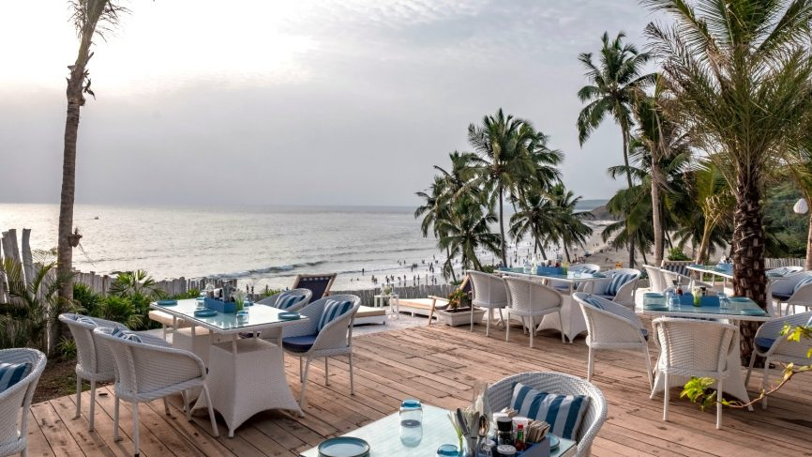
IBM Data Science Professional certificate Capstone
Harshad Pednekar

Slide 2
Introduction/Business Problem
Goa is the smallest state in India having an area of only 3702 sqkm. It is a multicultural state that has a Portuguese culture which is a vestige of the Portuguese rule 70 years ago. Over time Goa has changed drastically in terms of its residents and the types of occupations it offers. Goa is home to Christians, Hindus, Muslims and other religious belief system.
Therefore it makes it an ideal location for Business that caters to needs of a variety of people. It is also good location for tourists who like to experience different cultures in a single place. Goa is one of the popular tourist destinations of India due to its vast heritage and location near the coast whose beaches attract tourists from India as well as from foreign countries.

Slide 3
Introduction/Business Problem
Past few years Goa has seen an increase in the tourists visiting it and thus provides a great opportunity to businessmen to cater the needs of these tourists. However, not every location in Goa is ideal for business like resorts, hotels and restaurants. Businessmen from outside Goa try to get in their share of market place by starting their business here. The business location plays a vital role in determining the success of the business.
Businesses poorly located can lead to significant loss for the business owner since it does not provide significant returns. A Chinese restaurant in a residential area will be less likely to gain customers than if it were located in a area which has entertainment and leisure services like movie theaters, shopping malls,theme parks etc. Indian culture favors homemade food and thus Goans are less likely to visit a restaurant unless they are visiting such entertainment and leisure areas.
The target audience of this analysis are business owners looking to start their business in Goa but do not know which is the ideal location for their business which would help them maximize their profits. One example of this is, where would a person start a restaurant such that he is sure enough people will visit it to sustain the business.

Slide 4
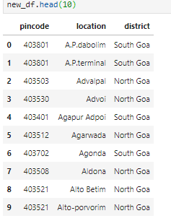
Data
To solve the above problem we will require location data of Goa. We will get this data from https://www.mapsofindia.com/pincode/india/goa/south-goa/ . Goa has 2 districts hence we will also need to get the data from https://www.mapsofindia.com/pincode/india/goa/north-goa/ to get the pincodes(postal codes) and the locations from north Goa.
To retrieve this data we will use the request and BeautifulSoup library to fetch the html pages and then parse the data into respective dataframes. The final dataframe after retrieving data (using the BeautifulSoup library) from both webpages and combining will look as shown.

Slide 5
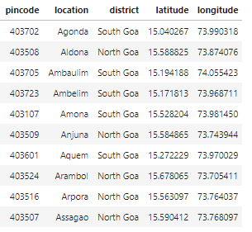
Methodology
1. Getting the coordinates of the towns of Goa.
We get the location coordinates of Goa using the Nominatim function from Geopy
Some of the towns coordinates are not available. These are useless entries and we will remove them. Our final dataframe with the coordinates looks like:

Slide 6
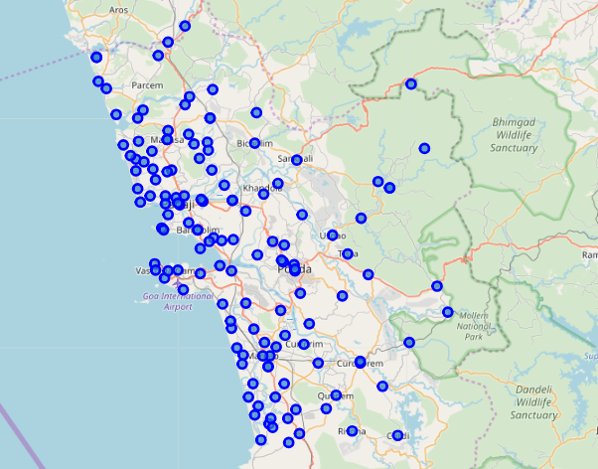
Visualising the Goan locations

Slide 7
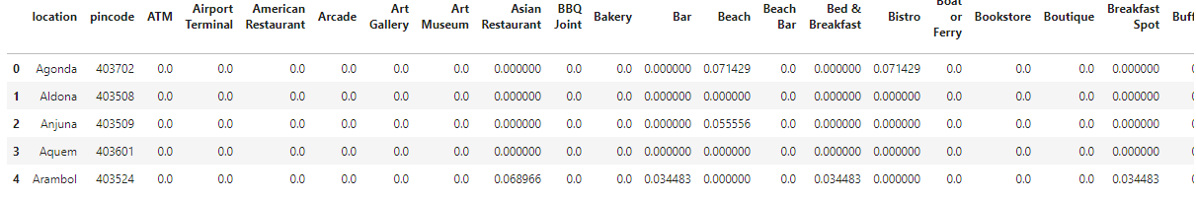
Using Foursquare api to retrieve the venues
Using our api credentials – client id and key we define a function to retrieve the venues of the location coordinates in the dataframe.
Next in order to work with these different types of locations we encode the categorical venues using the onehotencoder.
We then group the data based on location , which will give us the frequency of occurances of the venue types per location. We will then use this grouped dataframe to retrieve the commonly visited locations. Since we need the most frequently visted locations we will sort these locations based on the frequency rates and get the top 5 most visited location of each town.

Slide 8
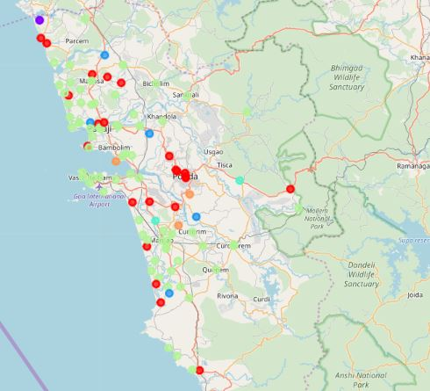
Clustering
Now that we have our most visited locations we perform clustering since we want to group locations with identical venue visit patterns . We use the K-means Clustering algorithm to cluster the locations into categories of locations which will be profitable for a new restraurant and those that will likely result in a loss.
Visualizing the clusters

Slide 9
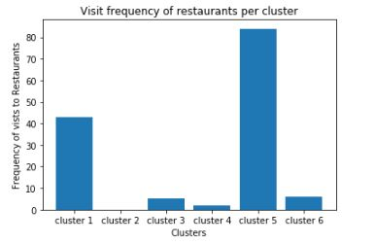
Results
We see that locations from cluster 1, cluster 6 and cluster 5 show a very good rate of visits to restaurants. Locations from these clusters are ideal to startup an restraurant since people are more likely to visit a new restaurant in these areas rather then the ones in cluster 2,3 and 4. These locations provide a very high chance of profit and investors are less likely to suffer loss.
Locations from cluster 5 shows the highest frequency of visits to restaurants and these locations are likely to provide the most profit for an restaurant owner as people from these location show a high tendency to visit different restaurants and food places especially Indian Restaurants.

Slide 10
Discussion
Since location of a business is very crucial it is important to choose it wisely. We see that some regions favour restaurants whereas others do not.
This study could have been taken further by considering the tourist visit rates to these locations and the different types of families that live in Goa. For example, the Older section of the society prefers Goan restaurants whereas the younger generation likes the western food.
Since some locations were omitted due to unavailability of their coordinates, the results could have been better.

Slide 11
Conclusion
The study shows us that a few of the locations from Goa are not suitable for new restaurants.
If a person wishes to start a restaurant then it will much more profitable if he chooses an location from clusters 1 and 5. These locations would be the ones that I would recommend.
----THANK YOU----

